Slide 1
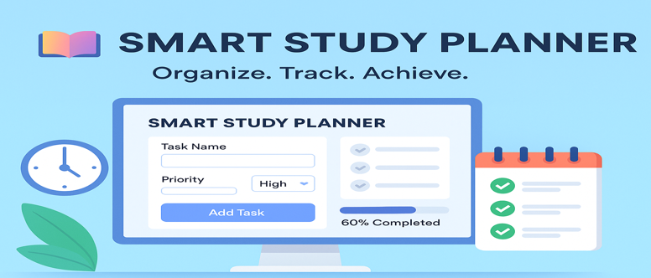
SMART STUDY PLANNER
CAPSTONE PROJECT
Presented By:
K. Sai Kowshik-Amrita Vishwa Vidyapeetham, Bengaluru

Slide 2
OUTLINE
Problem Statement
Project Overview
End Users
Tools & Technologies
System Approach
Algorithm / Workflow
Design & Layout
Features & Functionality
Deployment
Results & Screenshots
Conclusion
GitHub Link

Slide 3
Problem Statement
Students face challenges in managing study routines effectively.
Lack of structured planning leads to missed deadlines and reduced productivity.
Existing apps are often too complex or require accounts and internet connectivity.
Need for a simple, lightweight, offline-accessible planner.
The solution should be user-friendly and customizable to individual goals.

Slide 4
PROJECT OVERVIEW
A web-based study planner built using HTML, CSS, and JavaScript.
Enables students to create, view, edit, and delete study tasks.
Provides visual progress tracking with timelines.
Uses Local Storage for storing data, ensuring offline usability.
Focused on simplicity, speed, and accessibility.

Slide 5
END USERS
Primary | Secondary | General Users
School students(daily homeworks and assignments) College students(semester planning and exam prep) Competitive exam aspirants | Teachers(to design study plans) Professionals(for personal productivity) | Anyone needing a task manager without login hassles.

Slide 6
TOOLS AND TECHNOLOGIES
Frontend: HTML5 (structure), CSS3 (styling, responsiveness).
Programming Language: JavaScript (logic & interactivity).
Data Storage: Local Storage API (saves data locally in the browser).
Deployment: Netlify / CCBP hosting (smartplanner1.ccbp.tech).
Testing: Browser-based testing (Chrome, Edge).
Design Tools (Optional): Figma / Canva (UI ideas).

Slide 7
SYSTEM APPROACH
Input: User enters tasks, deadlines, and goals.
Processing: JavaScript validates input, stores tasks in Local Storage.
Output: Tasks displayed dynamically with options (edit/delete/mark complete).
Feedback Loop: Task progress visually updated, motivating the user.
Data Flow:
User → UI (HTML/CSS) → Logic (JavaScript) → Storage → Output Display.

Slide 8
ALGORITHM
Start application.
Check Local Storage for existing tasks.
If tasks exist → load them into UI.
Else → show empty planner.
User adds a task → validate input → store in Local Storage.
Update UI dynamically.
User can edit/delete/mark complete → update Local Storage accordingly.
Continue until user exits.
On next visit, previously stored tasks are retrieved automatically.

Slide 9
DESIGN AND LAYOUT
Homepage: Clean UI with task input box.
Task List: Organized view of tasks with status indicators.
Controls: Add, Edit, Delete, Mark as Complete buttons.
Responsive: Works on both desktop & mobile screens.
Color Theme: Minimalistic, eye-comforting layout.
User Experience: Designed to avoid clutter and maximize readability.

Slide 10
FEATURES AND FUNCTIONALITY
Add, Edit, Delete, and Update tasks easily.
Data saved locally without login or database.
Visual progress tracking of completed vs pending tasks.
Reminders & timelines for effective scheduling.
Fast, lightweight, and secure (no external data sharing).
Cross-platform usability (works on any browser).
Responsive design for all devices.

Slide 11
DEPLOYMENT
Developed and tested locally using browsers.
Hosted using CCBP Tech platform for free access.
Accessible at https://smartplanner1.ccbp.tech/
Requires no installation, just an internet browser.
Deployment ensures:
Cross-device access (mobile, laptop).
Zero dependency on external servers.

Slide 12
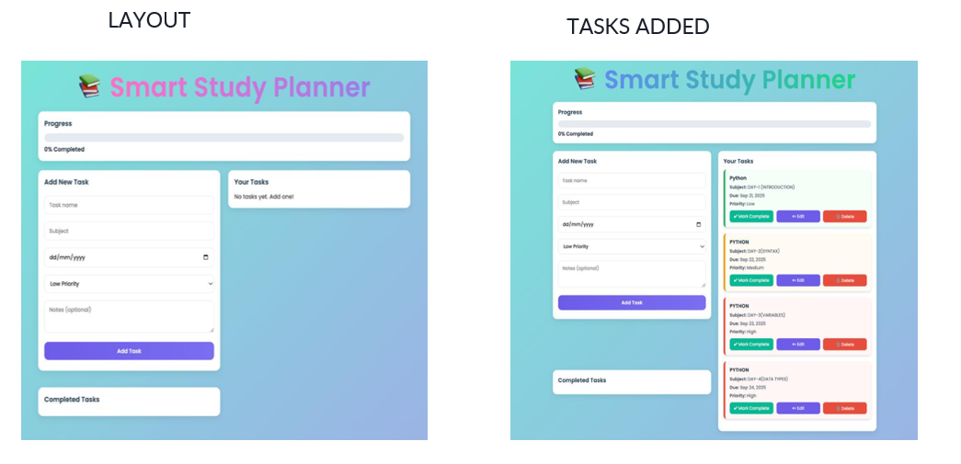
RESULTS & SCREENSHOTS

Slide 13
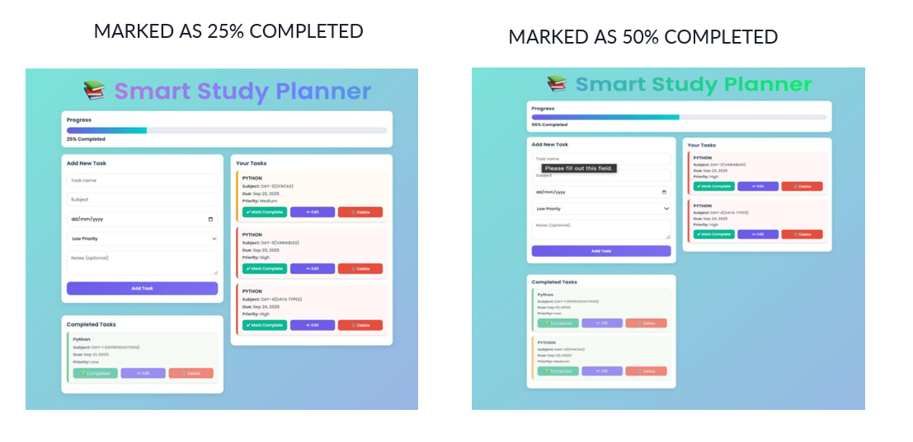
RESULTS & SCREENSHOTS

Slide 14
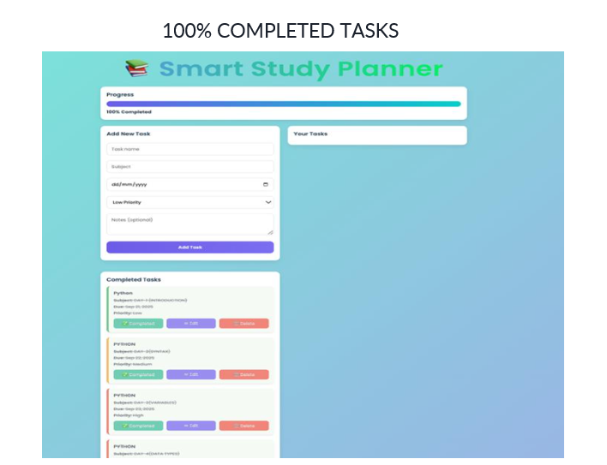
RESULTS & SCREENSHOTS

Slide 15
CONCLUSION
Smart Study Planner improves time management and academic productivity.
Provides an offline, secure, and simple alternative to heavy task apps.
Future Enhancements:
Cloud sync for multi-device usage.
Push notifications for deadlines.
Integration with Google Calendar.
Group task-sharing features.

Slide 16
GITHUB
GitHub User ID : saikowshikkurra
GitHub Link : https://github.com/saikowshikkurra/Smart-Study-Planner/tree/main
Smart Study Planner : https://smartplanner1.ccbp.tech/

Slide 17
THANK YOU!!

